Slide 1
4.3 Newton's method

Slide 2
Since the first order Taylor series approximation to a function leads to the local optimization framework of gradient descent, it seems intuitive that higher order Taylor series approximations might similarly yield descent-based algorithms as well.
In this Section we introduce a local optimization scheme based on the second order Taylor series approximation - called Newton's method.

Slide 3
Because it is based on the second order approximation Newton's method has natural strengths and weaknesses when compared to gradient descent.
In summary we will see that the cumulative effect of these trade-offs is - in general - that Newton's method is especially useful for minimizing convex functions of a moderate number of inputs.

Slide 4
Example: The descent direction provided by second order Taylor series approximation

Slide 5
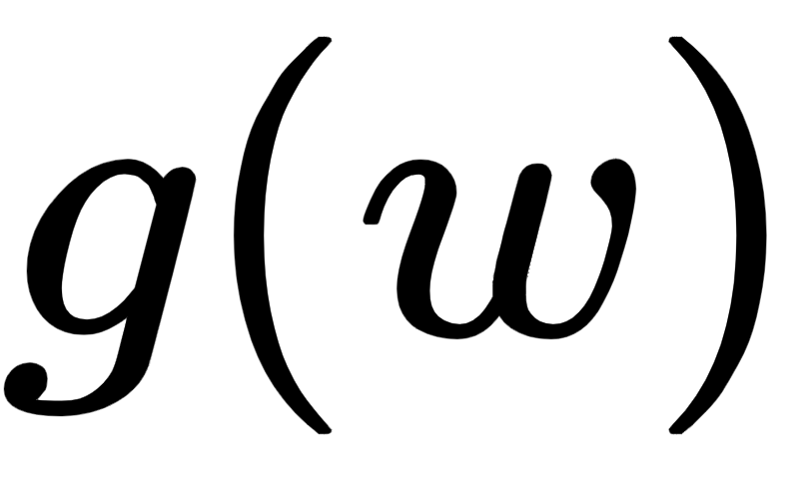

The second order Taylor series approximation of a single input functions at a particular point is a quadratic function of the form
This is - typically speaking - a much better approximation of the underlying function near than is the first order Taylor series approximation on which gradient descent is built.

Slide 6
Example: Single input Taylor series of a sinusoid

Slide 7
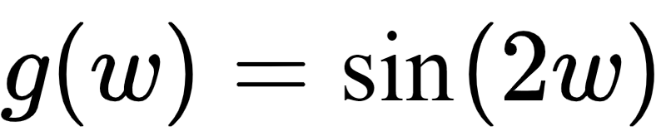
Below we animate a single-input function , along with its first and second order Taylor series approximation.
As the animation proceeds a point (shown as a red dot) on which the approximations is based moves left to right, producing new approximations.

Slide 8
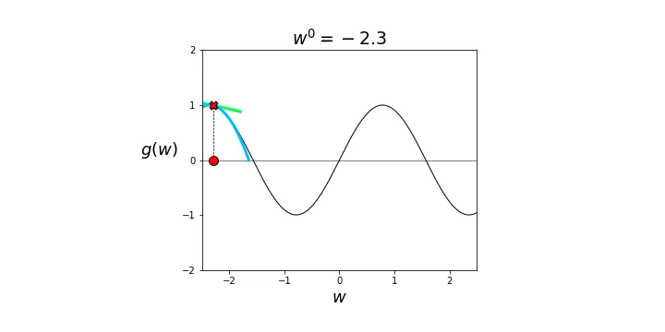

Slide 9
One can see that at each point the second order approximation (in blue) is a much better local approximator than the first order analog (in green).
Note how the second order approximation matches the local convexity/concavity of the function g, i.e., where g is convex/concave so too is the quadratic approximation.

Slide 10
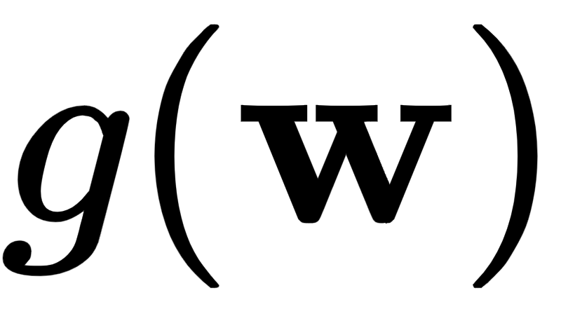

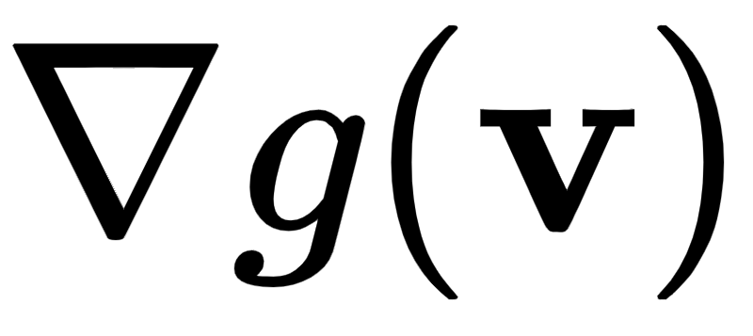
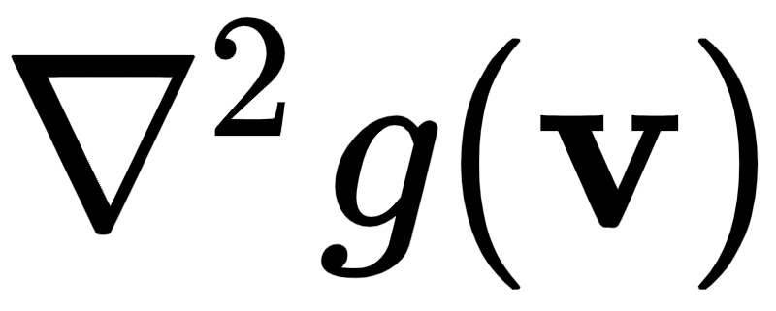

This natural quadratic approximation generalizes for functions taking in N inputs, where at a point the analogous second order Taylor series approximation looks like
Here is the gradient vector of first order partial derivatives, and is the Hessian matrix containing second order partial derivatives of g at

Slide 11
Example: Multi-input Taylor series of a sinusoid

Slide 12
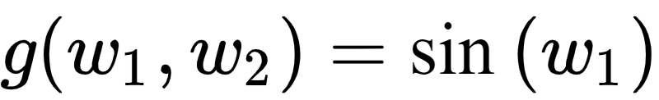
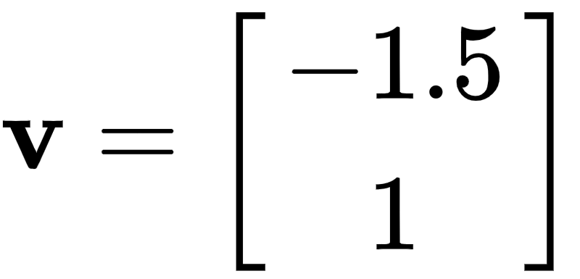
Below we show an example comparing first and second order approximations (in green and blue respectively) using the sinusoid at the point
Clearly the second order approximation provides a better local representation of the function here.

Slide 13
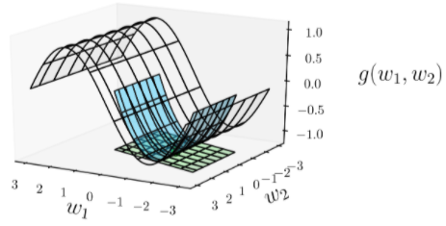

Slide 14
In analogy to gradient descent, what would it mean to move in the 'descent direction' defined by the second order approximation at ?
Well unlike a hyperplane, a quadratic does not itself have such a descent direction.
However it does have *stationary points* which are global minima when the quadratic is *convex*.
Like the descent direction of a hyperplane, we can actually compute the stationary point(s) fairly easily using the first order condition for optimality (described in Section 3.2)

Slide 15
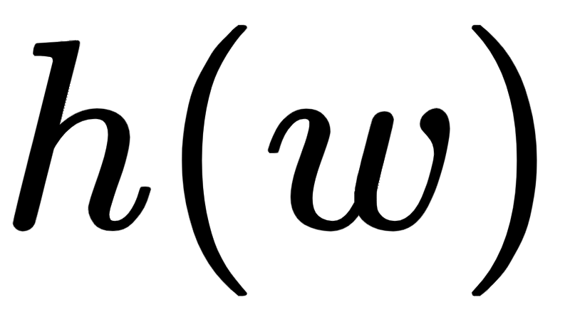
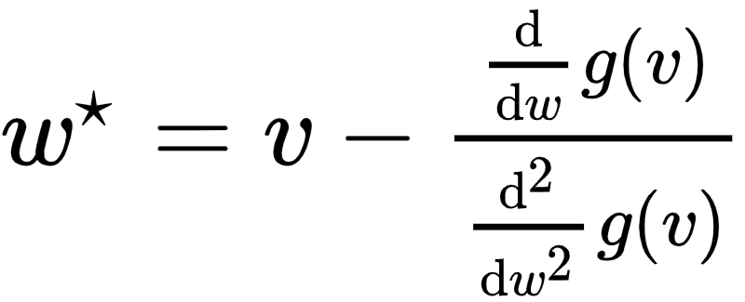

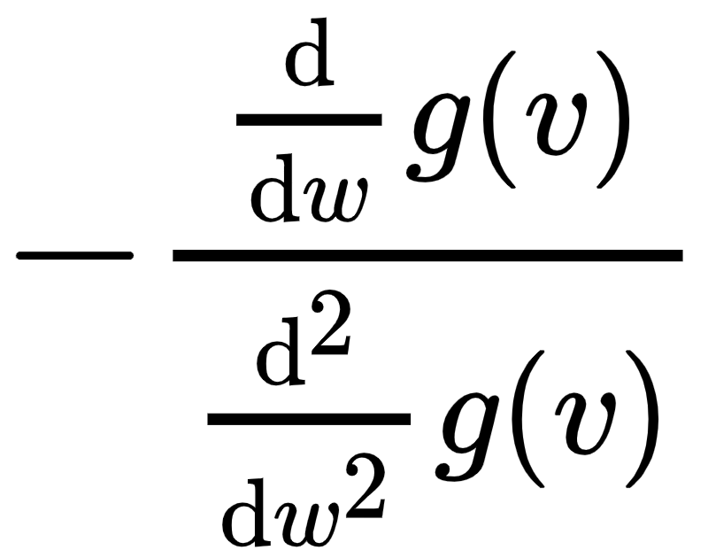
For the single input case of the second order Taylor series approximation centered at a point we can solve for the stationary point of the quadratic approximation by setting the first derivative of to zero and solving.
Doing this we compute the point
Note that this update says that to get to the point we move from in the direction given by

Slide 16

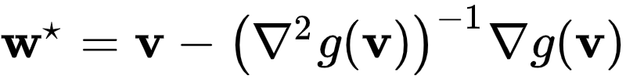

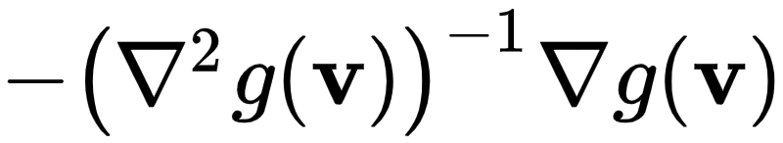
The same kind of calculation can be made in the multi-input case. Setting the gradient of the quadratic approximation to zero and solving gives the stationary point where
This is the direct analog of the single-input solution, and indeed reduces to it when .
It likewise says that in order to get to the new point we move from in the direction

Slide 17
So in this notation, what might happen if we have a general function and at the point we form the second order Taylor series approximation there, calculate a stationary point of this quadratic, and move to it from ?
When might this lead us to a lower point on g ? In other words, when might be a descent direction? Let us examine a few examples to build up our intuition.

Slide 18
Example: Studying where the stationary point of the approximating quadratic leads on several convex functions

Slide 19
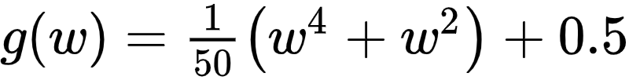
Below we illustrate this idea for the function
Beginning at an input point v (shown as a red circle) we draw the second order Taylor series (in light blue) for the above function at this input, marking the point on the graph of g where it is tangent as a red X.
We mark the stationary point of our quadratic along the input axis with a green circle, marking the evaluation of both the quadratic and original function at this point with a dark and green X's respectively.

Slide 20
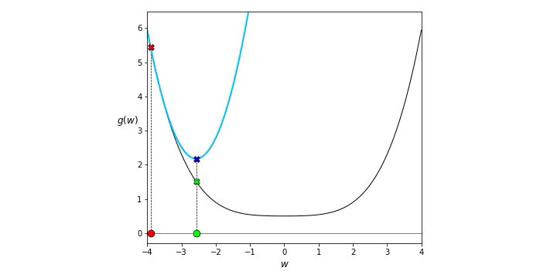

Slide 21
Moving the animation slider back and forth we can note that - because is convex - the quadratic approximation is always convex and facing upward, hence its stationary point is a global minimum (of the quadratic).
In this particular instance it appears that the minimum of the quadratic approximation always leads to a lower point of the function than where we begin at v.

Slide 22
Example: Studying where the stationary point of the approximating quadratic leads on a sinusoid

Slide 23

Below we illustrate this idea for the function
using the same visualization scheme and slider widget as in the previous example.

Slide 24
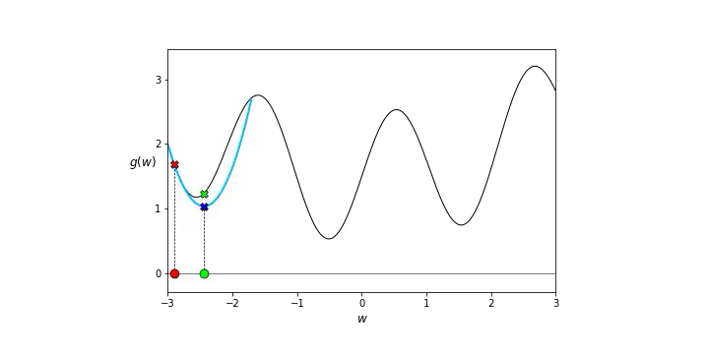

Slide 25
Here the situation is clearly different, with non-convexity being the culprit.
In particular at concave portions of the function the stationary point of the quadratic approximation is a global minimum of the approximator, and tending to lead us towards points that increase the value of the function (not decrease it).

Slide 26
From our cursory investigation of a few simple examples we can intuit that this idea could produce a powerful algorithm, particularly for minimizing convex functions.
This is indeed the case, and the resulting idea is called the Newton's method algorithm.

Slide 27
Newton's method

Slide 28
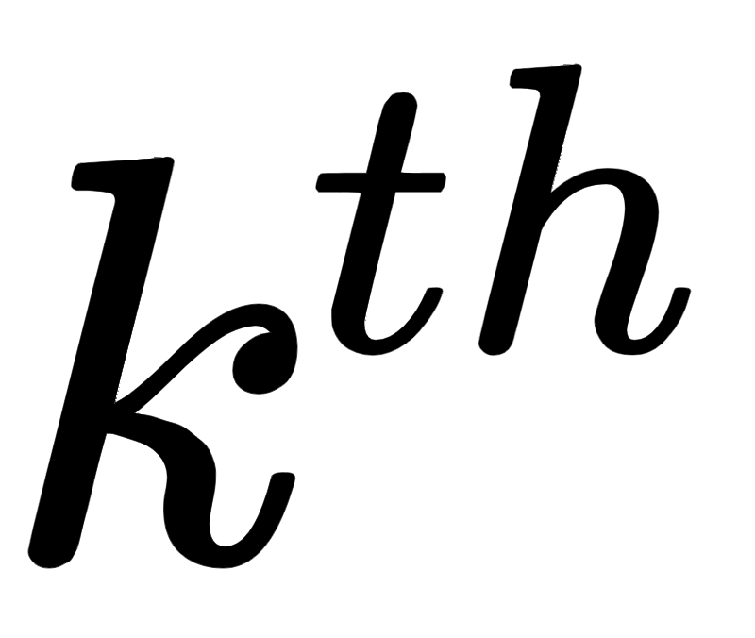
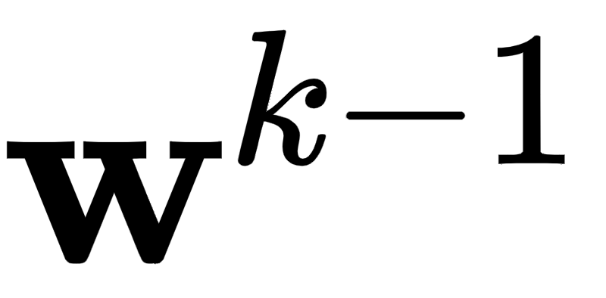
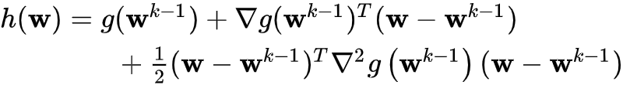
Newton's method is the local optimization algorithm produced by repeatedly taking steps that are stationary points of the second order Taylor series approximations to a function.
Repeatedly iterating in this manner, at the step we move to the stationary point of the quadratic approximation generated at the previous step which is given as

Slide 29
A stationary point of this quadratic is given - using the first order condition for optimality - as

Slide 30
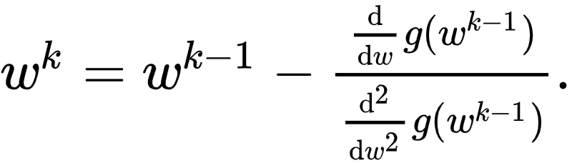
Notice for single input functions this formula reduces naturally too

Slide 31
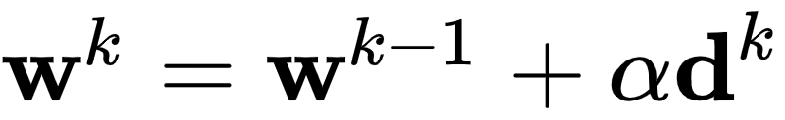

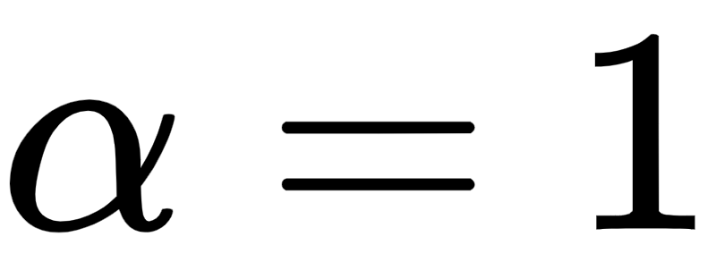

This is a local optimization scheme that fits right in with the general form we have seen in the previous two Chapters
In the case of Newton's method the direction and .
Here the fact that the steplength parameter is implicitly set to 1 follows naturally from the derivation we have seen.

Slide 32



We illustrate Newton's method visually in the figure below.
Starting at an initial point Newton's method produces a sequence of points that minimize by repeatedly creating the second order Taylor series quadratic approximation to the function, and traveling to a stationary point of this quadratic.

Slide 33
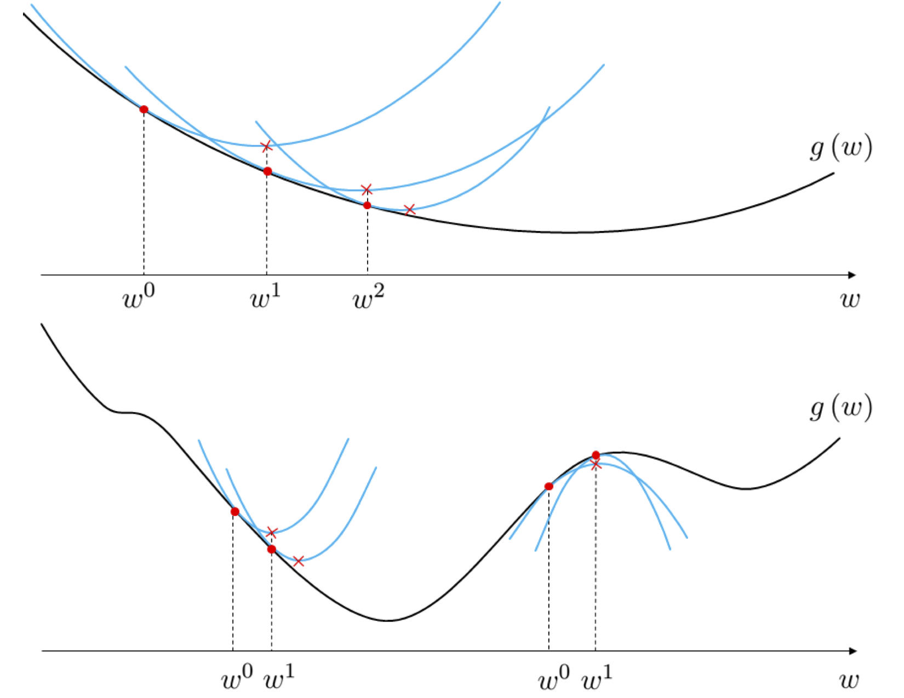

Slide 34
Because Newton's method uses quadratic as opposed to linear approximations at each step, with a quadratic more closely mimicking the associated function, it is often much more effective than gradient descent in the sense that it requires far fewer steps for convergence.
However this reliance on quadratic information also makes Newton's method naturally more difficult to use with non-convex functions since at concave portions of such a function the algorithm can climb to a local maximum, as illustrated in the bottom panel of the figure, or oscillate out of control.

Slide 35

Note how we must invert the Hessian in the update step as written
This is expensive computationally speaking.
Instead is typically found via solving the equivalent system of equations (which can be done far more efficiently)

Slide 36
Ensuring numerical stability

Slide 37
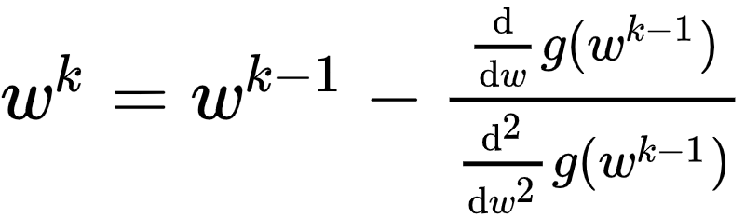
- Take the single-input Newton step

Slide 38
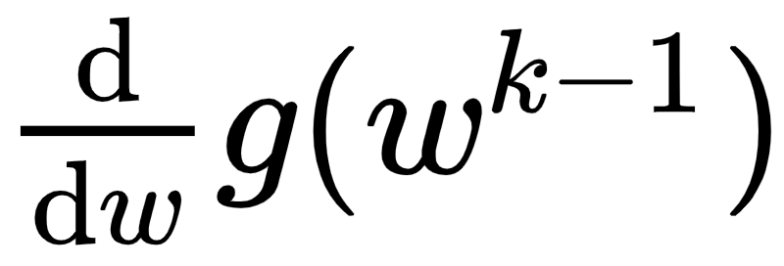
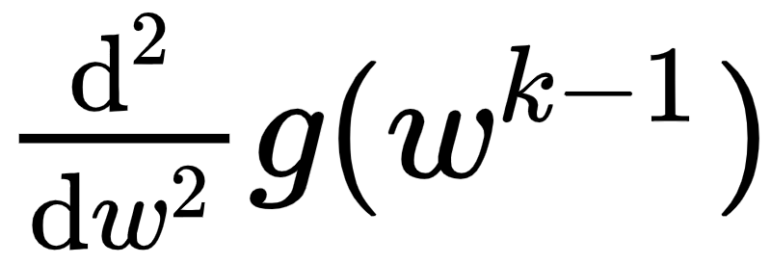
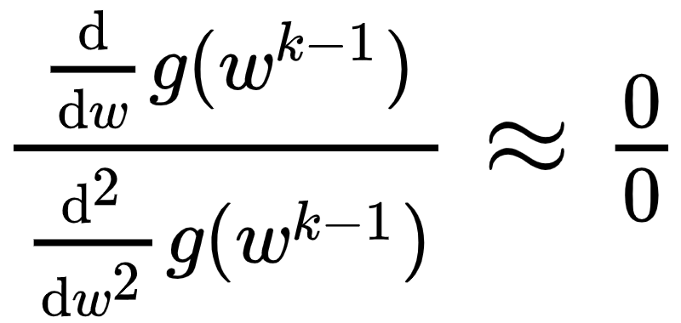
Near flat portions of a function both and are both nearly zero valued.
This can cause serious numerical problems since once each (but especially the denominator) shrinks below machine precision the computer interprets

Slide 39

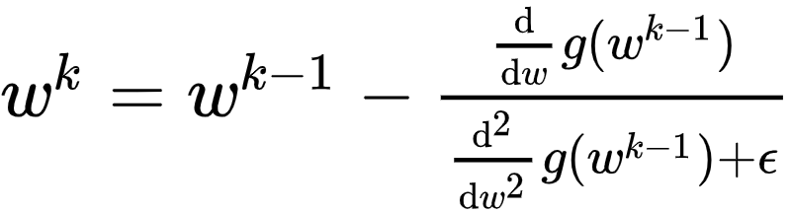
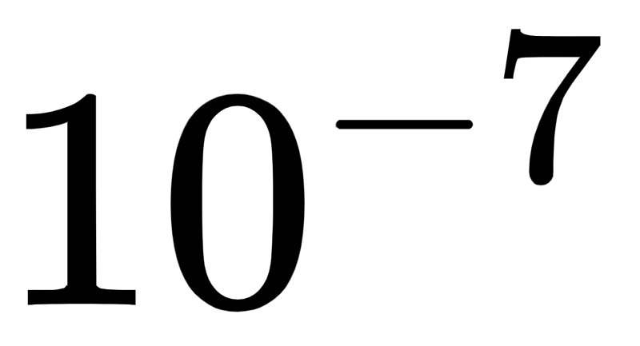
One simple and common way to avoid this potential disaster is to simply add a small positive value to the second derivative - either when it shrinks below a certain value or for all iterations. This regularized Newton's step looks like the following
The value of the regularization parameter is set by hand to a small positive value (e.g., ).

Slide 40
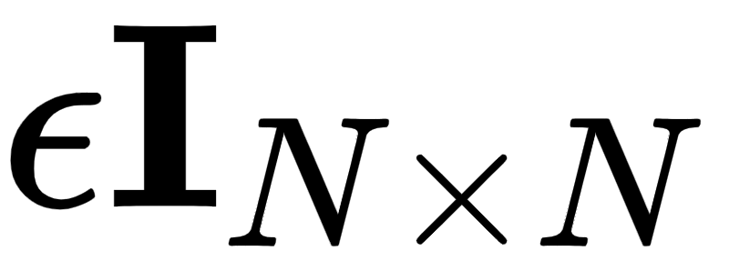
The analogous adjustment for the multi-input case is to add - a identity matrix scaled by a small positive value - to the Hessian matrix.
This gives the completely analogous regularized Newton's step for the multi-input case

Slide 41
Example: Animating Newton's method applied to a convex single-input function

Slide 42

Below we animate the process of performing Newton's method to minimize the function

Slide 43
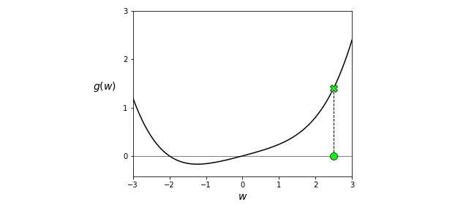

Slide 44
Example: Minimizing a quadratic function with a single Newton step

Slide 45
In the right panel below we apply a single Newton step to completely minimize the quadratic function
Newton's method will minimize any convex quadratic in a single step. Why?
For comparisons-sake we show a run of gradient descent in the left panel, where many more steps are required.

Slide 46
